Slide 1
CRAFTY-GB

Slide 2
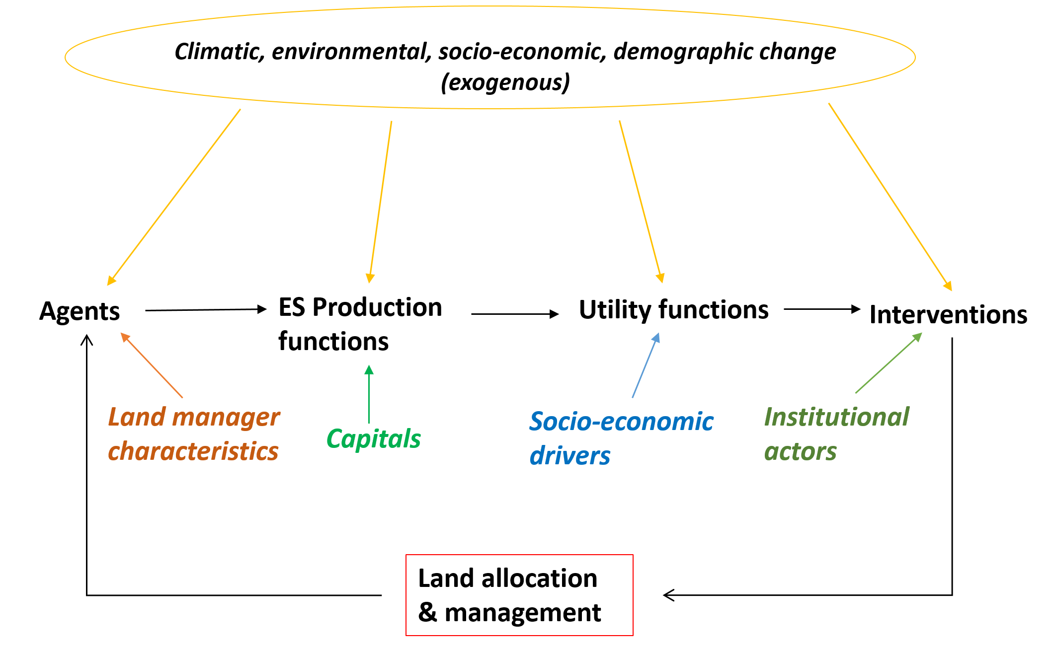
CRAFTY basic model structure
CRAFTY (Competition for Resources between Agent Functional Types) framework simulates land use change on the basis of:
Societal demand for ecosystem services
Converted to economic & non-economic benefits
Land manager agents compete on the basis of benefit values and behavioural characteristics
Agents then use capitals describing potential production to provide ecosystem services
Institutional agents intervene to achieve desired outcomes
Benefit functions

Slide 3
CRAFTY basic model structure
Designed to operate over large geographical extents and complete land systems, including e.g.
Agricultural land uses
Productive & non-productive forest management
Urban areas
Conservation
Range of intensities, objectives and multi-functionalities of each
Model is driven by inputs describing climatic & socio-economic scenario conditions, affecting e.g.
Yields
Demand levels
Financial inputs
Social capital
Agent knowledge, social networks, attitudes
Internal and external trade
Used to explore, e.g.
Effects of different supra-economic behaviours
Non-equilibrium dynamics
Environmental feedbacks
Institutional interventions

Slide 4

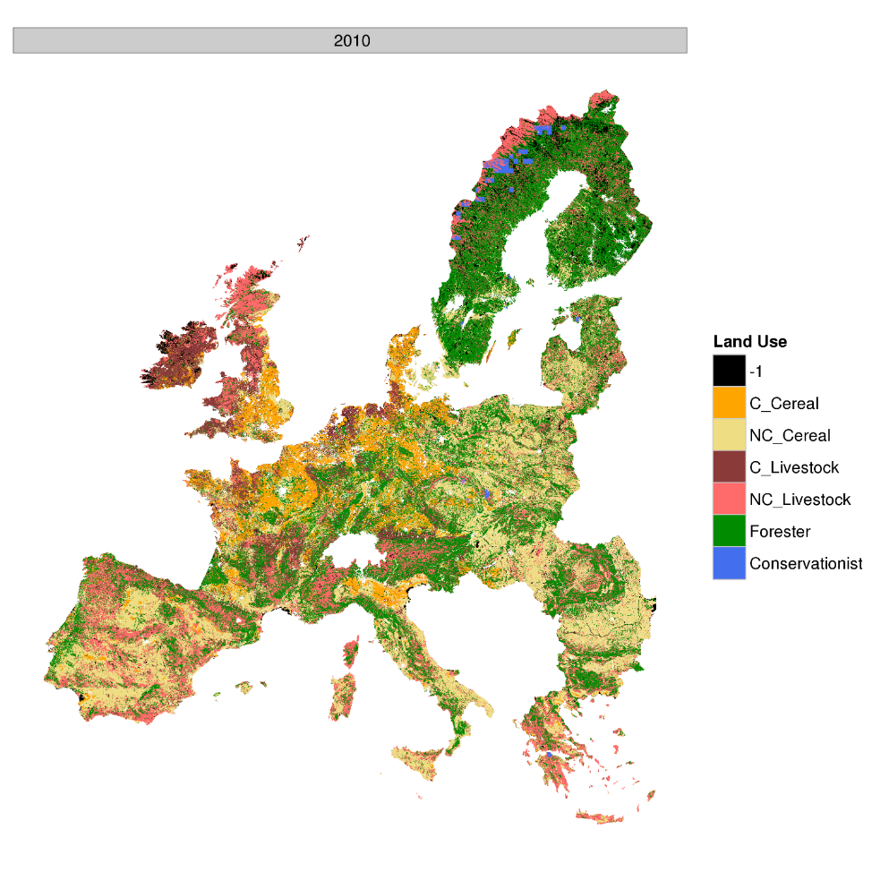
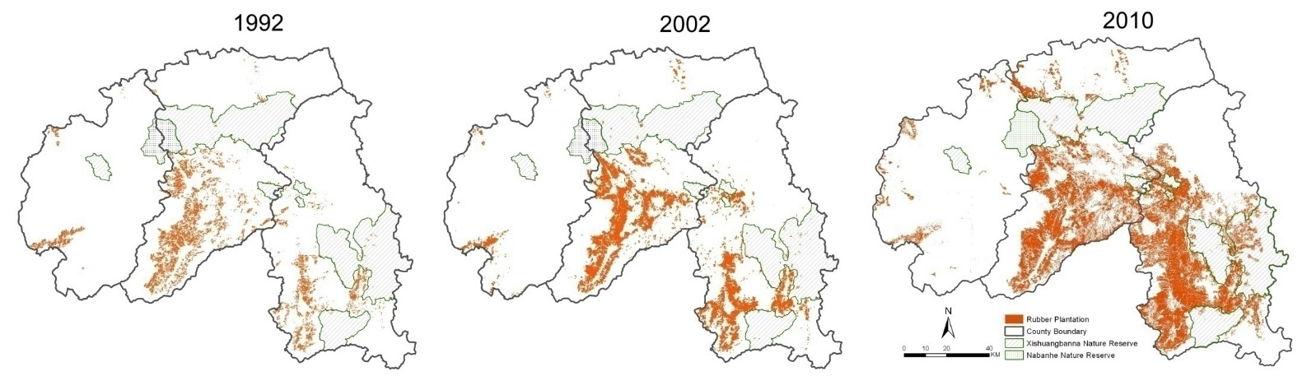
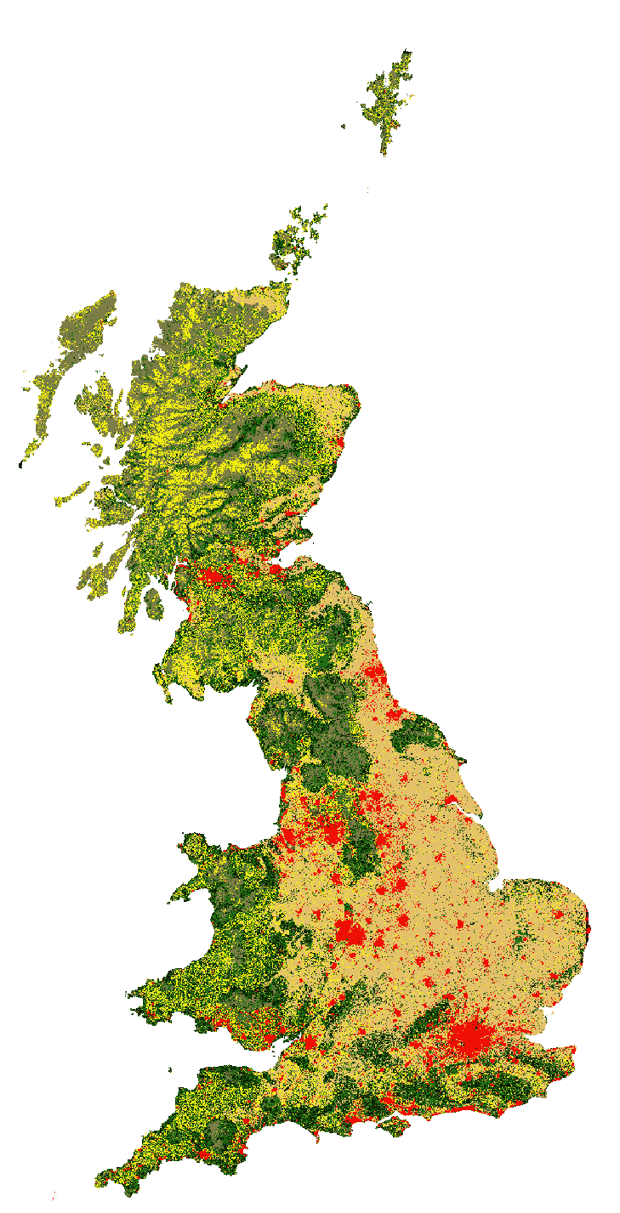
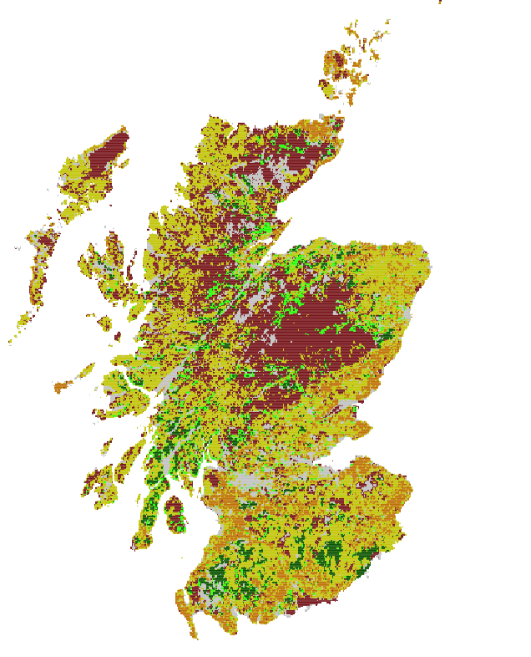
Series of CRAFTY-framework applications:
CRAFTY-Europe
CRAFTY-Yunnan
CRAFTY-Scotland
CRAFTY-UK
CRAFTY-Sweden
CRAFTY-DE
Under construction…..

Slide 5
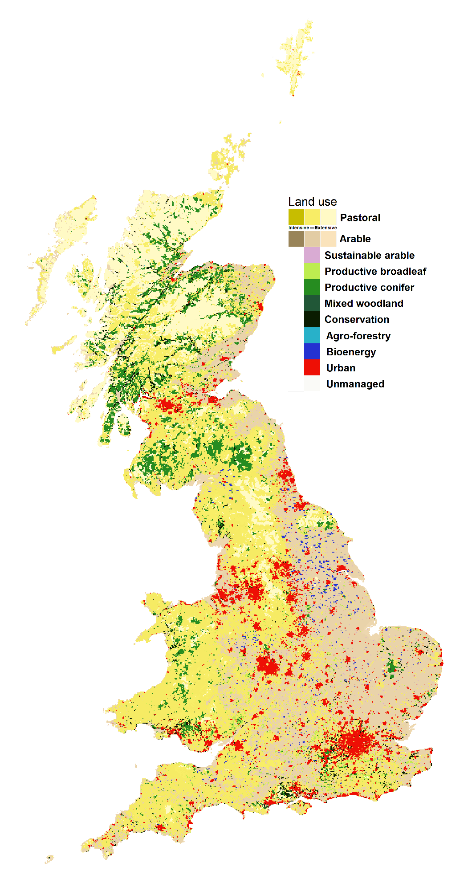







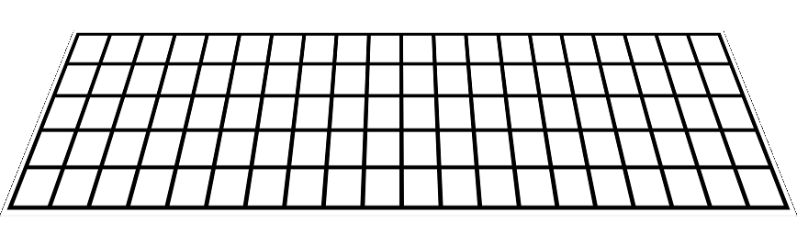
CRAFTY GB overview
CRAFTY core model supplied by range of inputs from data and model sources (substitutable)
LandSyMM
global land system model
Global food production & trade
Societal requirements
provisioning, regulating, cultural and supporting services
UK food demands
Non-food demands
FUTURE SCENARIOS
Ecosystem services
RCPs
HADGEM
= data input
= model input
SSPs
Stakeholder storylines
supply
demand
PRESENT DAY
CRAFTY core: Land use change
Baseline land cover
from remote sensing and field survey data:
UK CEH Land cover map 2015
National Forest Inventory 2016
Translated into
Agent (land use) types
Parameterise
Behaviours
Social networks
Willingness to change land use
Individual heterogeneity
Suitabilities
Arable, pastoral from statistical model
Forest types from ESC model
masks
Capitals
Human, Social, Manufactured, Financial
Urban areas
Baseline land cover
Future defined by urban model

Slide 6
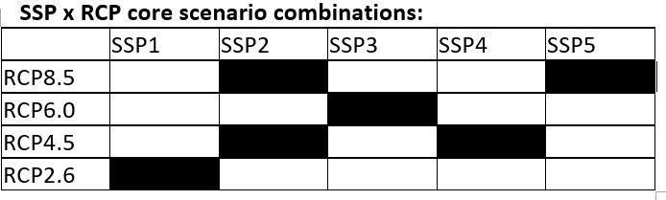
CRAFTY GB scenarios
Currently operating over several scenario combinations:
Scenarios are implemented through a range of conditions:
Climatic conditions affect
Crop suitabilities/yields
Tree species growth & timber production
Global production and trade demands
Socio-economic conditions affect
Human, social, financial & manufactured capitals
Forest & crop yields through technology
Societal demand for ecosystem services
Valuation and benefits for ecosystem services
Urban land areas
Agent behaviours: production characteristics, responses to competition and demand, social networks & knowledge
Global production and trade

Slide 7
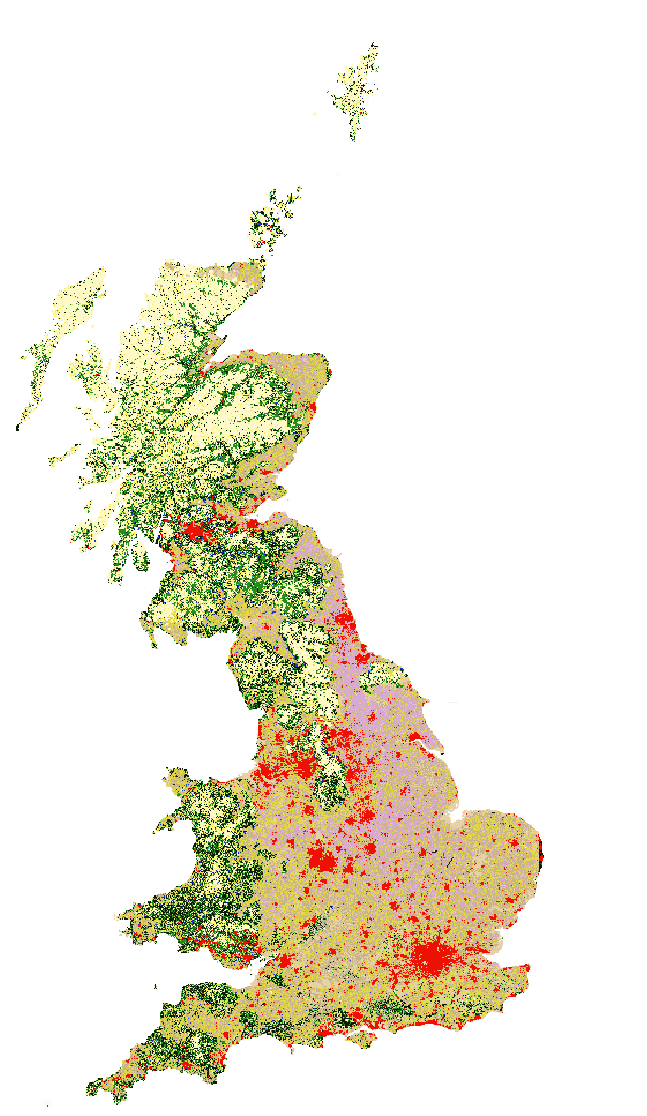
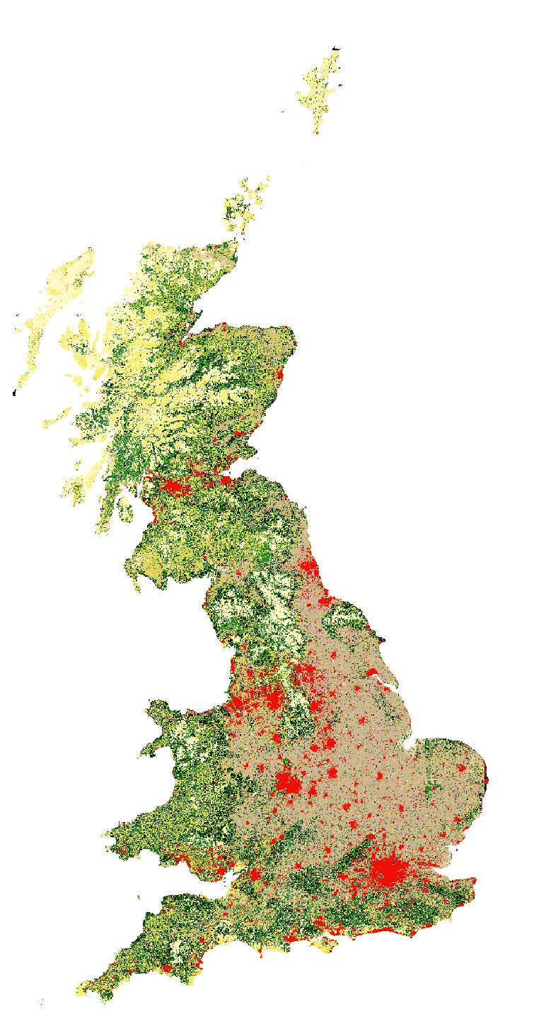
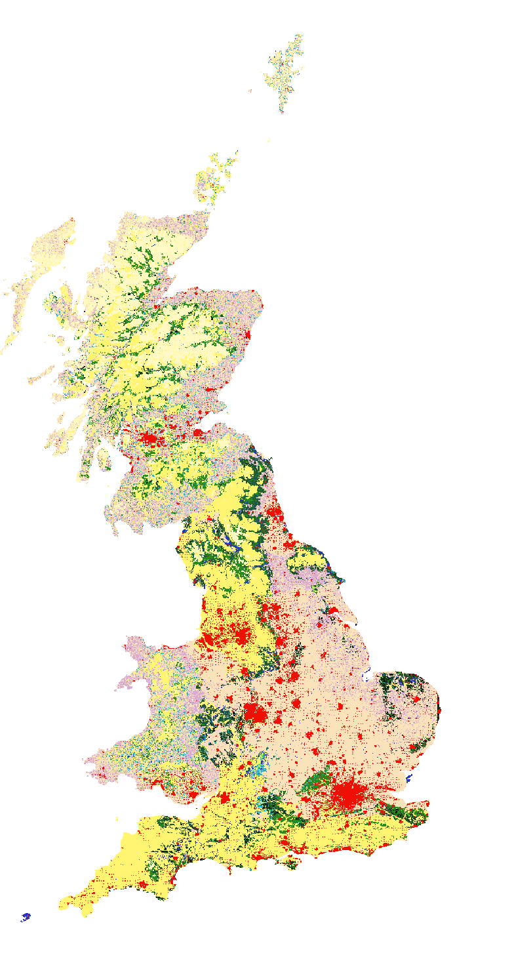
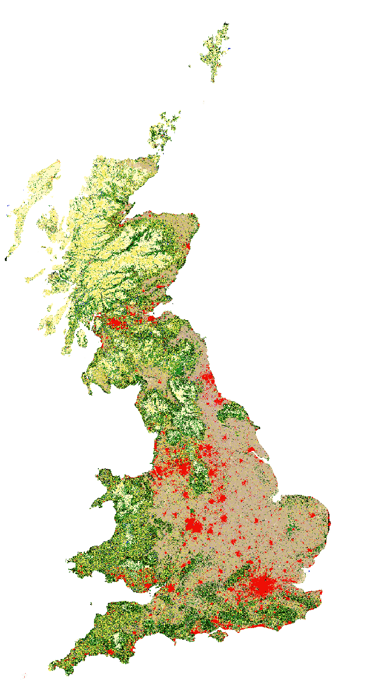
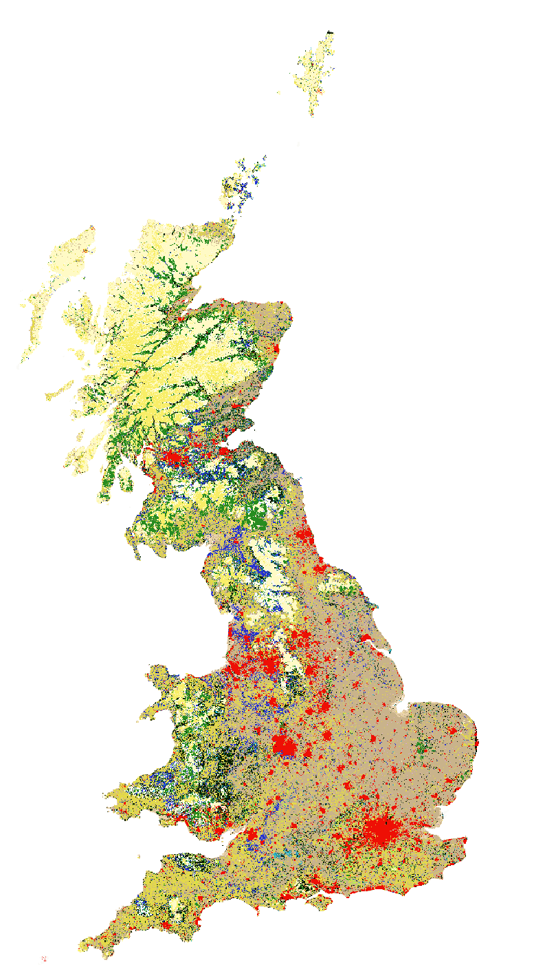
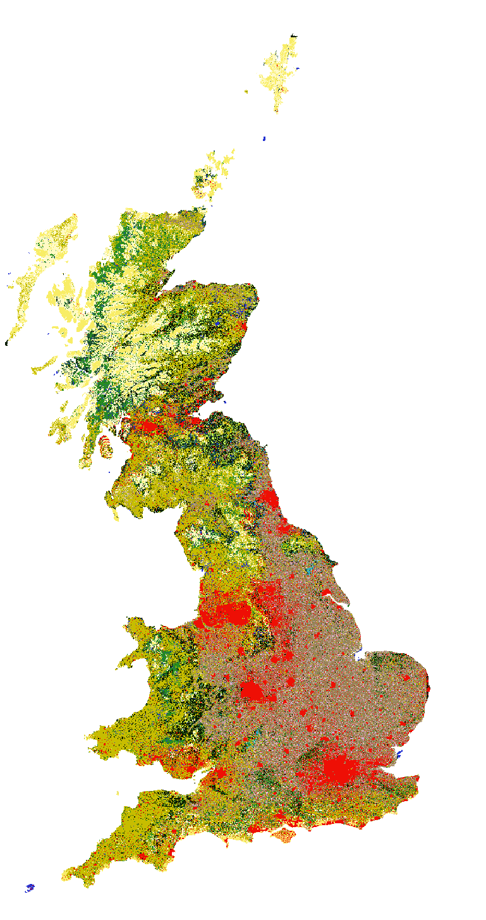
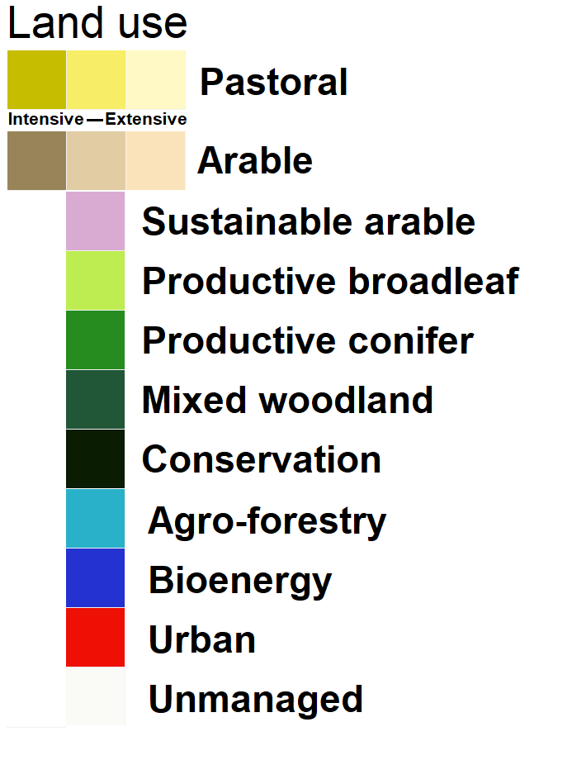
2080 maps
RCP2.6-SSP1
RCP8.5-SSP2
RCP6.0-SSP3
RCP4.5-SSP2
RCP4.5-SSP4
RCP8.5-SSP5

Slide 8
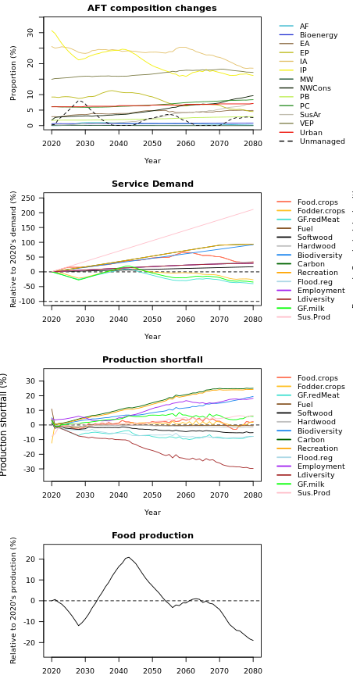
SSP1-RCP2.6
Main changes: Large-scale switch to sustainable production (including native species in forestry), also with a large increase in conservation and some abandonment. Relatively limited intensification (as plotted here). The most ‘sustainable’ outcome of all the scenarios
Although this scenario has a higher proportional demand for grass-fed livestock products, overall food demand decreases later in the scenario and technologically-driven yield increases occur in grass-fed, extensive & agro-forestry systems. This leads to a reduction in the area of most forms of agriculture.
Meanwhile, increasing demand for environmental benefits and sustainably-produced products mean that sustainable management and conservation increase substantially, offsetting area losses of conventional agriculture
Carbon, recreation, employment and biodiversity demands are not entirely satisfied

Slide 9
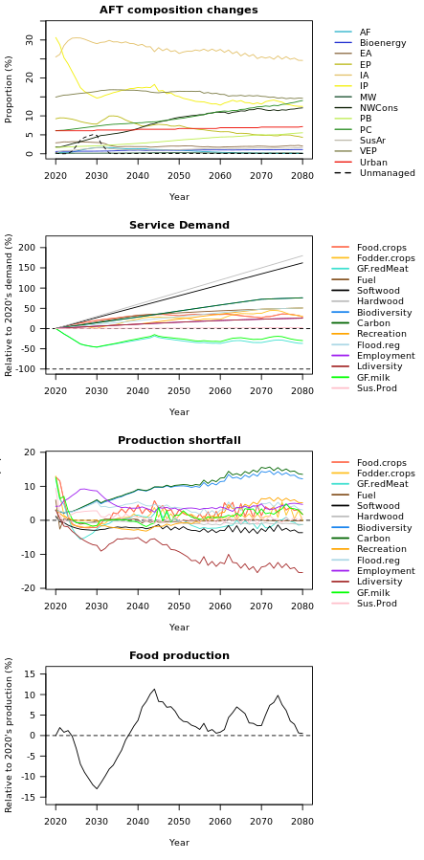
SSP2-RCP4.5
Main changes: Arable area largely maintained, and intensified. Lower demand for grass-fed livestock products leads to a sharp decline in intensive pasture, which also moves into less productive areas. Productive forestry (especially non-native species) increases substantially. Substantial increase in conservation in under-utilised upland areas.
Biodiversity and carbon demands are not quite satisfied because intensive production is favoured
Intensive arable remains concentrated in the south-east, extensive pastoral in the north-west

Slide 10
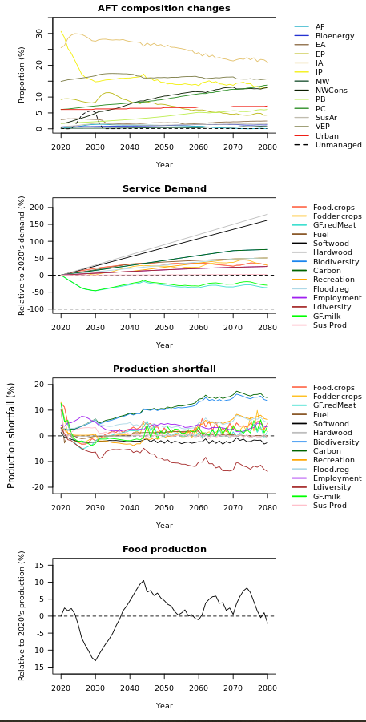
SSP2-RCP8.5
SSP2-RCP8.5 is very similar to SSP2-RCP4.5, with slightly larger decreases in intensive arable and extensive pastoral
Land use changes most obvious in Scotland, where pasture area decreases. In England, some conservation management takes over intensive pasture and extensive pasture spreads along the south coast

Slide 11
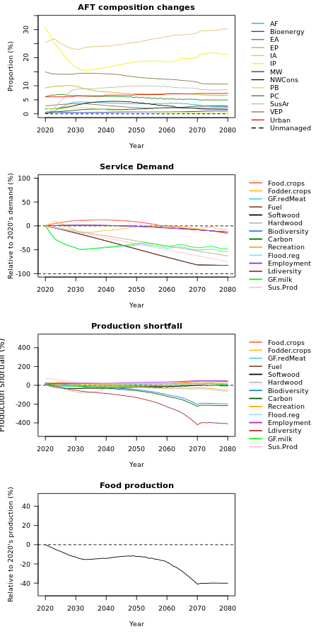
SSP3-RCP6.0
Main changes: Massive de-intensification of agriculture as inputs become unavailable. Pressure in land is highest in England, and management here is relatively the most intensive.
By 2080 there is little difference between modelled intensity classes, and sustainable arable spreads widely as it is capable of producing relatively well with few inputs (i.e. occurs by necessity rather than preference)
Abstract services (landscape diversity, biodiversity, carbon) are highly over-supplied because demands are low, but these are not penalised. Food and timber demands (which decrease) are mostly satisfied, though only with most land under some form of productive management.

Slide 12
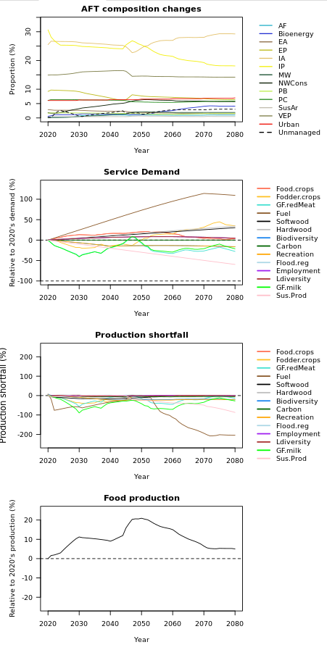
SSP4-RCP4.5
Main changes: Widespread intensification and dominance of agriculture, with arable area especially increasing. England particularly intensively-managed, though even here there is some abandonment and recreation management in the uplands. Bioenergy increases substantially in marginal agricultural areas to satisfy fuel demand, and ends up over-supplying
Large land holdings have a competitive advantage, and land use is particularly homogeneous in productive areas.

Slide 13
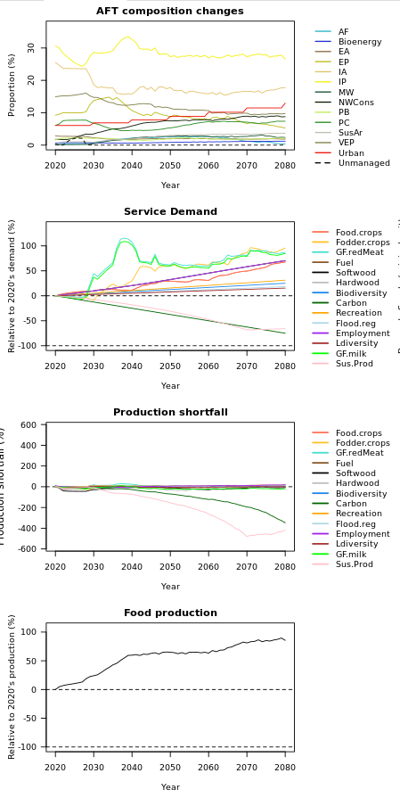
SSP5-RCP8.5
Main changes: Very strong intensification of agriculture across the UK. Urban areas grow a lot, and pasture area is maintained. Arable intensifies and shrinks in area. Extensive and forestry management generally pushed far north-west. Sustainable arable nevertheless strikes a competitive balance between food production and other services, and mixes with intensive.
Conservation areas are extensive and mainly but not exclusively in the uplands.
Protected areas are removed, allowing more land use change, as does declining social capital. Strong social networks allow for consolidation of dominant land uses.
Demands are satisfied, and there is far more sustainable production and carbon sequestration than society requires.

